Slide 1
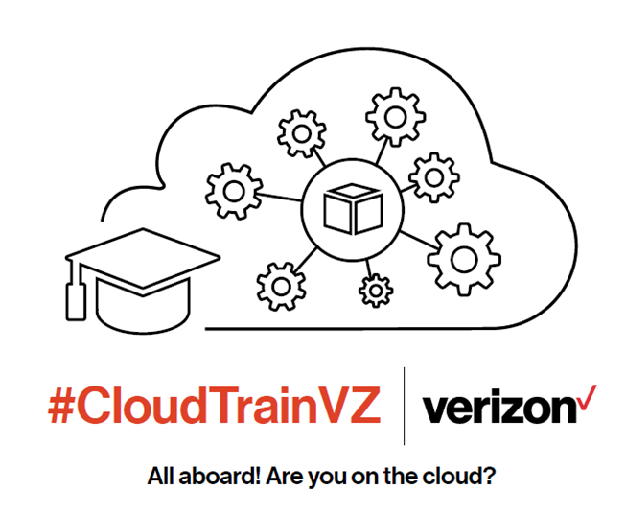

CloudTrainVZ Bootcamp Kick-off for Certified Solutions Architect - Associate
September 2018
Matthew Eig
Cloud Training Manager
GTS Technology Transformation Team
Verizon IT, Global Technology Services

Slide 2
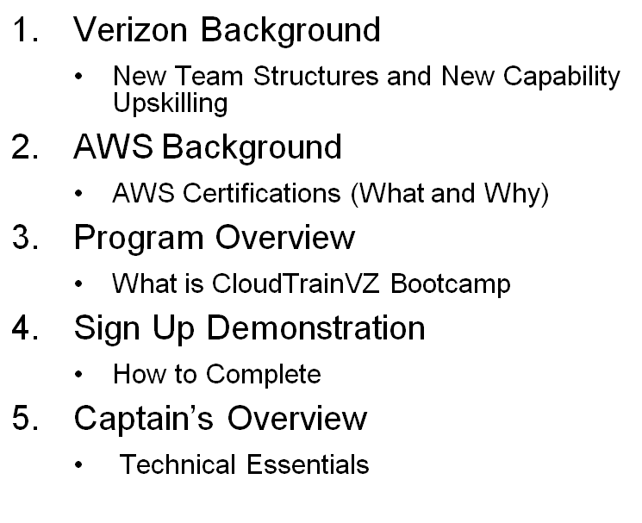

Agenda
Verizon Background
New Team Structures and New Capability Upskilling
AWS Background
AWS Certifications (What and Why)
Program Overview
What is CloudTrainVZ Bootcamp
Sign Up Demonstration
How to Complete
Captain’s Overview
Technical Essentials
2

Slide 3
Verizon Background

Slide 4











Enablement Capabilities
Value Creation
Business
Development
PS, Ops & Security
Infrastructure
Agile
Fixes This
DevSecOps
Fixes This
Cloud
Fixes This
Notes:
Enablement tracks needs to be seamless.
Where dies this course fit in with the transformation?
Dojos, Agile initiatives, devops initiatives
To enable you to operate effectively in the cloud environment
To be more agile as a dev org

Slide 5


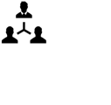

Verizon Transformation Journey
Teams - Today vs. Tomorrow
Product Manager
Developers
CAMs/PMs
Product
Owners
Scrum
Masters
Testers
Implementers
Operations
Engineers
Current Organization
Waterfall • Sub-Optimal
Full-Stack Team
Autonomous • Self-Sustaining
→
→
Leader
Manage Projects
Coach
Enable Team
Notes:
A big part of the transformation is that skill sets are changing. We were in Silos so it was good to get deep in 1 area. Now its important to have multiple skill sets for smaller teams. Engineers for example are key because smaller teams do end to end deployment. Team members need broader skill sets and
We will all need to work in the cloud environment

Slide 6

Teams -Today vs. Tomorrow
We have latent talent, but we need to hack a learning culture into the organization.
We need to develop “T-shaped” talent to enable this transition.
T-Shaped Roles:
Each role is not an individual engineer
Roles transition over time to build generalists
Engineers still develop deep competencies in one or more roles
Manager is a coach and decision tiebreaker for the team
Notes:
Roles were I shaped (strong in one area). Now we all need to have multiple skill sets to be more well-rounded to fit the agile model

Slide 7
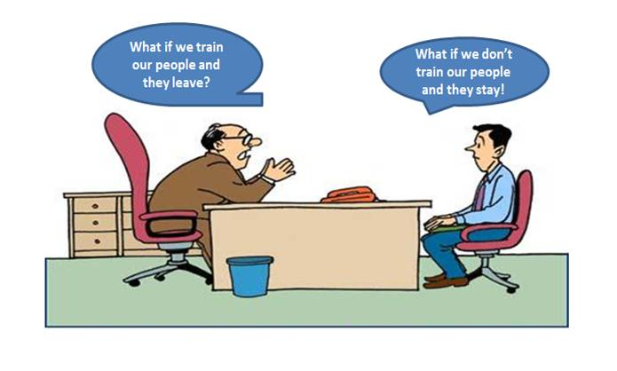
Early Adopter Group is Crucial to the Success of the Transformation Program
Notes:
We are making a substantial investment in IT, in YOU. We are building Dojos and upskilling our people. As our competitors are doing, we are also moving to a scrum based product environment

Slide 8
New Capability Upskilling
 | Product Owner | Scrum Master | Engineer
 |  |  | Code | DB | DevSecOps | CloudOps | Security
Capab i I i t i es | Developing Project Charters Managing a project backlog Prioritizing deliverables Maintaining a RACI Identifying velocity and driving planning | Understand Scrum Onboard a team into Scrum model Facilitate effective Scrum meetings Scale Scrum to large, multi-continent projects Continuous improvement | Understand 12 factor applications Know how to decompose larger applications Design for elasticity & resilience Reusable patterns and frameworks Open Source | Large scale distributed DB NoSQL DB Design multi site/hybrid DB replication DB changes via DevOps pipeline Data Virtualization as a service | Design a continuous delivery pipeline Enable automated testing for function, performance and security Provide continuous measurement and improvement instrumentation | Design Cloudformation templates Optimize cost for AWS services, and design for minimum viable infrastructure Evaluate and use cloud native services on AWS Architect roll forward/roll back and A/B environments | Build a threat assessment model Assess data protection, access management needs Build real time automated threat detection and reaction frameworks Engineer security into the CI/CD process
New Training/Certifications
New Tool Sets
Notes:
You will need skills in other areas besides your one silo. We want you to learn new tools to effectively manage applications in the cloud

Slide 9
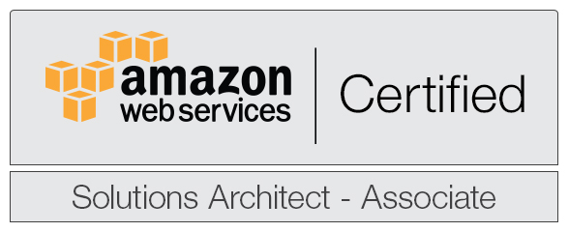
AWS Certifications - Consistent Knowledge Base
The AWS associate-level certification is a primary measure of basic cloud fluency. We want to help you become a Certified Solutions Architect – Associate.
The AWS Certification
Provides a high bar
Is a strong indicator of cloud fluency
Demonstrates core knowledge
Indicates demonstrable level of skills
Is highly regarded in the industry
A top paying IT certification
The Value of AWS Certification Training
AWS certification guarantees drawing from a single, consistent knowledge base
Ensures employees have a shared understanding of cloud computing
Creating a common knowledge encourages standard designs & implementation
Consistent operations will result in more efficiency and lower operational cost
Notes:
Who should get certified? Everyone in IT. It will become a requirement this year. So get certified and be a leader, be a mentor and help others.
Key point is that AWS training ensures a baseline level of competency is available. Then, you can get additional certs, so go out and get 3, 4, 5 certs.

Slide 10
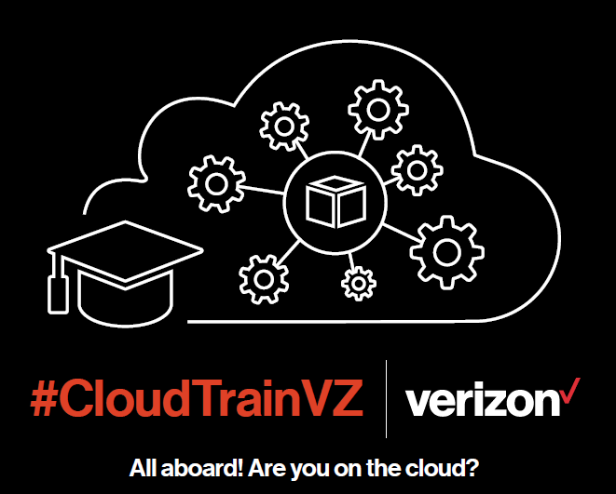
What’s In It For Me (WIIFM)?
AWS Certification
Coveted IT certification
Cloud Fluency
Knowledge on different AWS services
Knowledge on how to design on AWS and choose the appropriate services
Community
Group setting where you are learning with others
Opportunities to give back to the community
Goal
Every IT individual working on an application in any capacity must be AWS Certified before the application goes live in the Cloud*
* Any exception must be Director-approved
Notes:
Get ahead of the game. Before your app goes to the cloud, you should be certified. Avoid mistakes that could harm our environment and our company.
This cert is highly coveted. You will be a recognized industry expert. It is a boost to your career and its necessary for VZ.

Slide 11
AWS Background

Slide 12











Amazon History
1994: Jeff Bezos incorporated the company.
2005: Amazon Publishing was launched.
2007: Kindle was launched.
2012: Amazon Game Studios was launched.
2014: Amazon Prime Now was launched.
?
1995: Amazon.com launched its online bookstore.
2006: Amazon Web Services (AWS) was launched.
2011: Amazon Fresh was launched.
2013: Amazon Art was launched.
2015: Amazon Home Services and Amazon Echo were launched.
Notes:
Matt - 1 minute
Give away T shirt (s)
Mention 1995 = Book store
2006 AWS
Goes on to launch Kindle, Fresh, Prime, Echo, etc.

Slide 13


Amazon Web Services (AWS)
Enable businesses and developers to use web services to build scalable, sophisticated applications.
Storage
Development and Management Tools
Content Delivery
Analytics
Compute
Messaging
Database
App Services
Payments
Mobile
Networking
On-Demand Workforce
VPC
Notes:
Matt - 1 min
Enable businesses and developers to use web services to build scalable, sophisticated applications.
The AWS Certification is important because it:
provides a high bar
is a strong indicator of cloud fluency
demonstrates core knowledge
indicates demonstrable level of skills
is highly regarded in the industry
a top paying IT certification

Slide 14
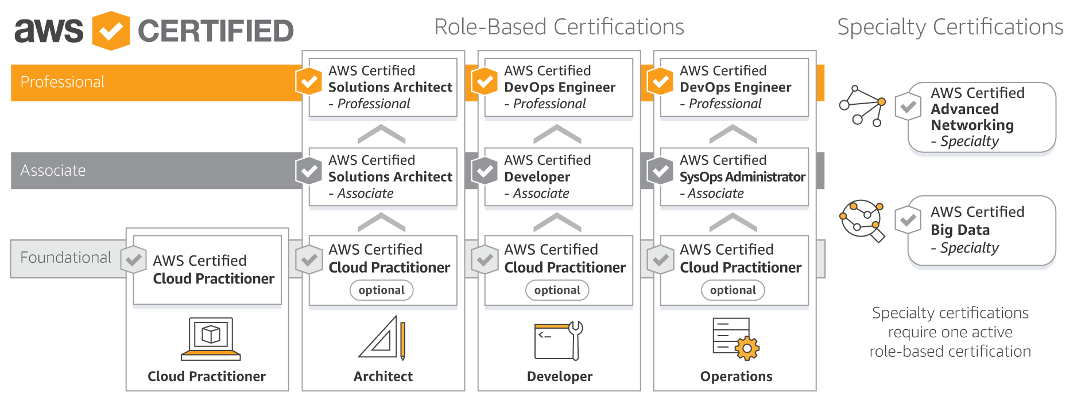
Certified Solutions Architect - Associate
Vouchers will be provided to cover ALL Associate-level exam costs*
* Completion of all Bootcamp Sprints is required.
Notes:
Matt – 2 Mins
The AWS associate-level certification is a primary measure of basic cloud fluency. We want to help you become a Certified Solutions Architect – Associate.
Rule 1:
All IT personnel (besides Director-approved exceptions) must get the AWS Certified Solutions Architect Associate certification (CSAA) at the minimum.
Cloud Program Office will sponsor the CloudTrainVZ Bootcamp training for CSAA and issue voucher for test fee of CSAA to individuals who completed all 6 sprints of the Bootcamp training.
Rule 2:
Additional certification courses / tests taken by individuals would not be sponsored by Cloud Program Office. Such courses / tests would be approved and sponsored by individual department based on manager discretion.

Slide 15
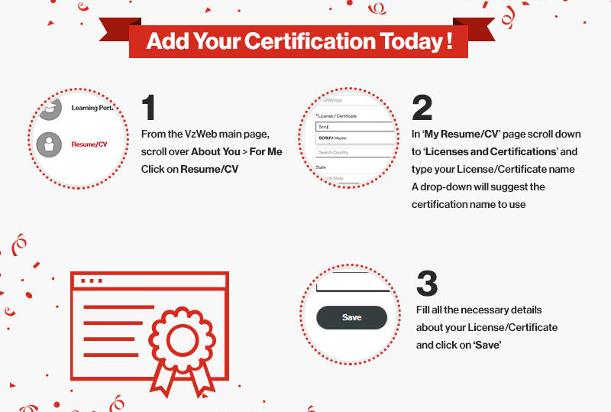
Notes:
It is essential that you add your certs to About Me!!!

Slide 16
Program Overview
Notes:
Matt

Slide 17





AWS CSAA Bootcamp September 2018
Group Learning
Self-Paced
Instructor-Led
On-Line Self-Directed
 | 1 |  | 2 |  | 3 |  | 4 |  | 5 |  | 6
 | Intro |  | Storage |  | Compute (3 weeks) |  | Databases |  | Networking |  | Final Touches
 | AWS - 10,000 Feet Overview IAM |  | S3 |  | EC2 & AMIs Security Groups Cloud Watch |  | RDS DynamoDB RedShift Aurora |  | DNS Route53 VPC |  | SQS SWF, SNS API Gateway Exam Tips
 | Onboard onto AWS |  | Work with S3 |  | Create an EC2 Instance |  | Create RDS |  | Work with ELBs
 | Overview of Amazon Web Services |  | Storage Options in the AWS Cloud |  | Architecting for the AWS Cloud |  |  |  |  |  | Well Architected Framework Best Practices
 | Sept 17 – Sept 28 |  | Oct 1 – Oct 12 |  | Oct 15 – Nov 2 (3 weeks) |  | Nov 5 – Nov 16 |  | Nov 19 – Nov 30 |  | Dec 3 – Dec 14
Labs
Dates
Group Sessions
AWS Essentials & AWS Exam Prep Session
Virtual Sessions
Notes:
Matt – 5 mins
This bootcamp is the basic foundation training that every IT individual must take to equip themselves with the skills to navigate correctly around the Verizon Cloud environment. Taking this training will ensure that you have the basic requisite skill to operate in the Cloud environment without inadvertently harming the Verizon Cloud infrastructure.
Note: Many training resources are available on the Bootcamp training sites (A Cloud Guru, Qwiklabs) to any student who want to pursue additional AWS certification training, however, the Cloud Program Office is only sponsoring the CSAA certification program at this time.

Slide 18
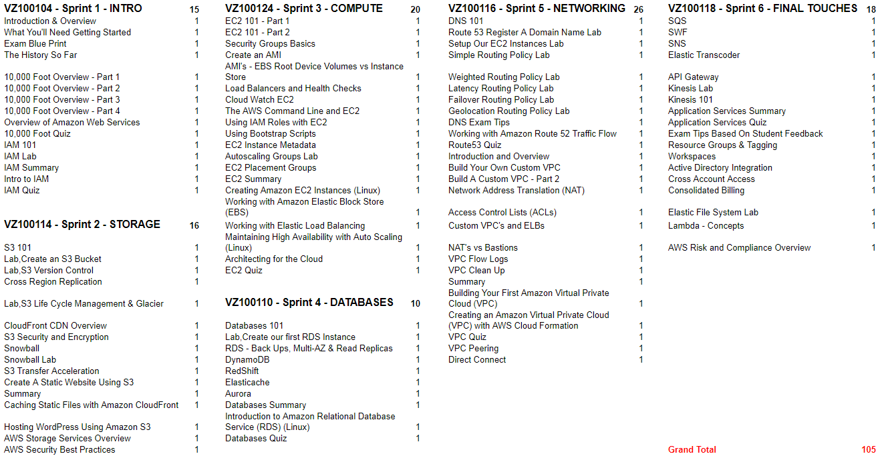
A Cloud Guru Curriculum Specifics
Notes:
Matt – 1 min
This is the specific curriculum. It is also posted the CloudTrain VZ site for your future reference.

Slide 19
Signing-up

Slide 20
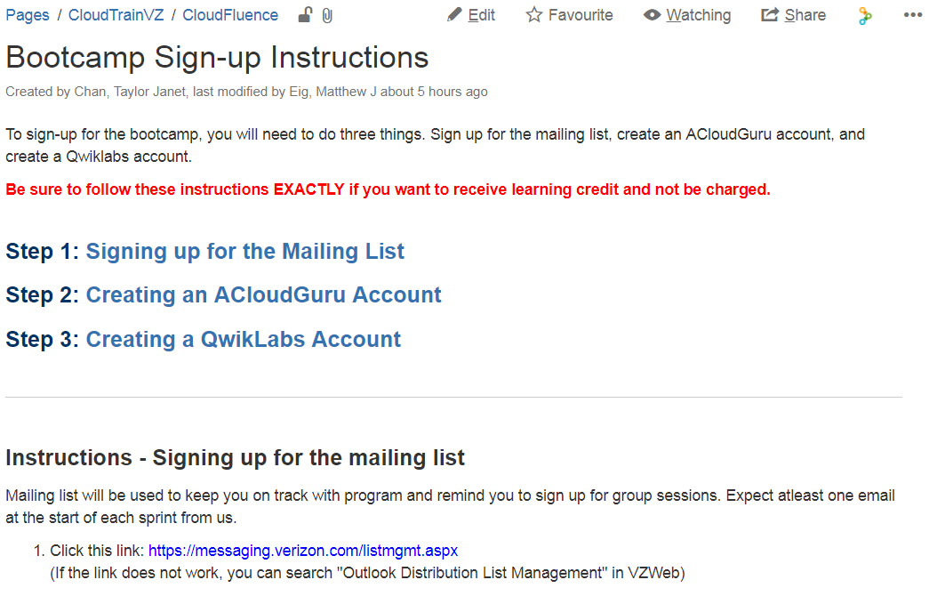
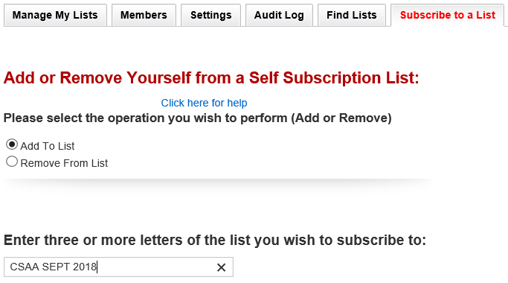
Signing Up – Mailing List (CSAA SEPT 2018) https://oneconfluence.verizon.com/display/CloudTrainVZ/Bootcamp+Sign-up+Instructions
Notes:
Matt – 2 mins
Hopefully everyone has done these 3 steps. The reason for mailing list is to be able to communicate with you and send you updates and info.

Slide 21
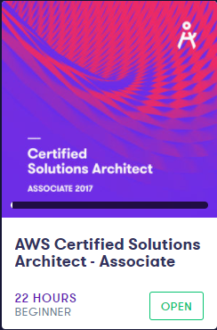
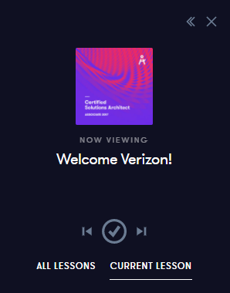
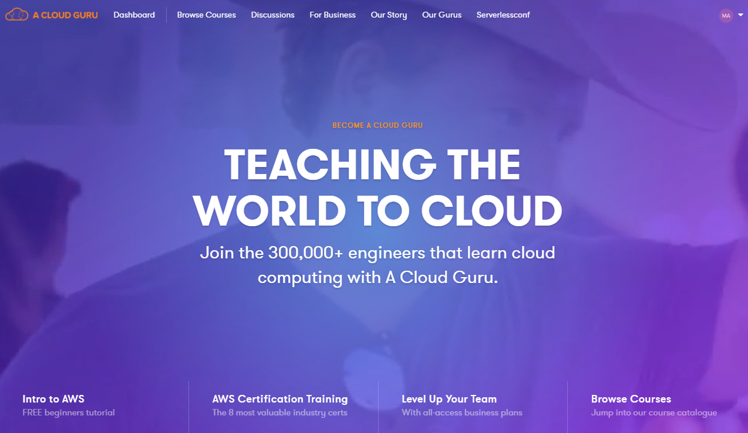
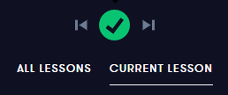

Signing Up - A Cloud Guru
Student creates an account in A Cloud Guru (ACG) using their Enterprise ID (not Employee ID) and Verizon email address to start taking courses per the CSAA curriculum.
Course completion is tracked via A Cloud Guru. All course videos, whitepapers and labs are REQUIRED to be marked as completed in ACG to receive full credit for the sprints. In Qwiklabs and for Whitepapers this is a manual process and you must “check the box” yourself to show completion of a section.
Not Complete
Complete
ACG training materials are covered with an Enterprise license. Employees with valid credentials can take any classes offered
When completed, you will see a check mark next to the section name
Notes:
Matt – 2 mins
Our ENTERPRISE ID is essential. That is how you will get credit for completing the material in ACG.
All videos fro ACG will automatically show a checked box, however the labs in Qwiklabs and the Whitepapers will ALWAYS need to be check manually.

Slide 22
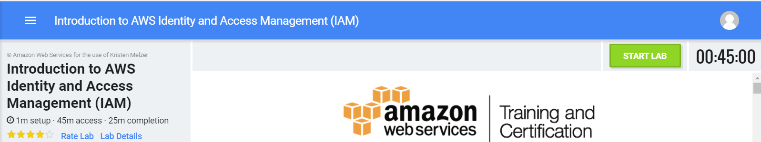
Signing Up - Qwiklabs
Create an account in Qwiklabs to start taking labs per Bootcamp curriculum. Account profile data needs to be accurate to receive proper course credit(s).
Qwiklabs’ labs are chargeable per instance of use. Sessions need to start and end in a timely manner to ensure best use of fees charged.
Each time you click “start lab” you spend credits. If you have previously started the lab, you will be charged again every time you start a new session.
No charge if you click the red “END LAB" button within 2.5 minutes of starting.
Upon completion of all required items indicated in the curriculum, a course completion is sent to Verizon’s Learning and Development (L&D) team. L&D will manually record and post course credit to your history. This process can take up to one week from actual completion.
It is YOUR responsibility to check and confirm credit shown for these VZ Learn records. Any related issues can be sent to L&D to address and resolve.
You MUST complete and “check off” all completions in the curriculum to be eligible for an Exam Voucher.
Notes:
Matt – 2 mins

Slide 23
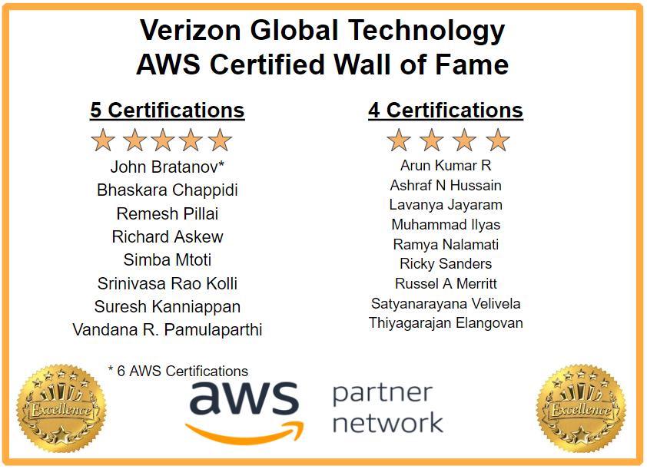
CloudTrainVZ
https://oneconfluence.verizon.com/display/CloudTrainVZ/CloudFluence
Keep an eye on our CloudTrainVZ site for information on upcoming sessions and events:
AWS Essentials Webinar
Group Sessions
Security Webinar
AWS Exam Prep Webinars
Notes:
Matt – 1 min
Matt = 20 mins

Slide 24

FAQ’s
Q: I already have ACloudGuru and Qwiklabs accounts from the first sprint offered earlier this year. Due to my job responsibilities and work hours I was not able to finish that sprint. I should have more time this go around. Does that mean I am already registered for this new sprint or do I have to do something else special to get registered to this new sprint?
A: You are all set. Please add your name to our new mailing list called “CSAA SEPT 2018” so we can keep you in the loop about upcoming sessions and more.
Q: I followed the steps on the CloudTrainVZ site, now My manager is asking me to register for the program course on VZLearn. How do I do that?
A: You don’t. When you complete the sections in A Cloud Guru, Qwiklabs and the Whitepapers (AND CHECK THE BOXES), you will be credited for each Sprint as a separate class in VZLearn.
Q: Can I have a exam voucher for other AWS certification exams?
A: Yes! We are now sponsoring all Associate-level exams.
Notes:
Matt – 2 mins

Slide 25


Captains Sessions
Before your group session
Review content of the Sprint
A Cloud Guru
Qwiklabs
Whitepapers
During the group session
Ask questions about that Sprint’s content
Help other students and encourage each other.
Learn about the “Verizon way” for the Sprint.
Leverage the knowledge of your peers.
Sign-up details coming soon:
Watch your email
Notes:
Matt – 1 min (or add to Cpt section)
It’s a WORKING SESSION. Ask questions and be prepared. Have taken ACG content and Lab work.

Slide 26
AWS Blogs, FAQs, and Discussion Threads
AWS Service FAQs - EC2, ELB, Auto-Scaling, RDS, Dynamo DB, VPC, CloudWatch, S3, Glacier, EBS, SNS, SQS, SES, Route53, Direct Connect, Cloudformation, Storage Gateway, IAM
Add this RSS feed to get up to date info about AWS services: https://awsinsider.net/rss-feeds/news.aspx
ACloudGuru Discussion Thread for sample questions:
https://acloud.guru/forums/aws-certified-solutions-architect-associate/top?p=1
Jayendra AWS Blog – Sample Questions: http://jayendrapatil.com/
Hands-On with Verizon AWS Cloud
Follow the AWS Twitter count for the latest updates
26

Slide 27
Thank You
Good luck
27

